Slide 1
Extended Task Resubmission
James Salazar 1269132
Mateusz Gren 1025504
Michael Lazarus 1206994

Slide 2
Content
Overview
Architecture
Implementation
Setup
Results

Slide 3








Overview
Overview
Architecture
Implementation
Setup
Results
Baseline:
Extension:
1)
2)
3)
1)
Success +1
3)
2)
Failure +1
Success +1
No Retransmit
No Retransmit

Slide 4
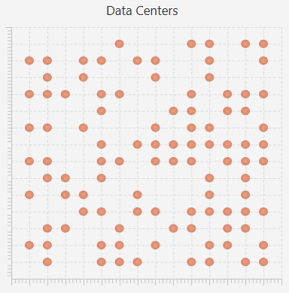
Architecture
Overview
Architecture
Implementation
Setup
Results
Grid
Fixed Size
Datacenter (DC)
Randomly Distributed
Physical Machine (PM)
Fixed Number / DC
CPU, Memory, Bandwith
Virtual Machine (VM)
Shares Memory of a PM
1 Job at a Time
Job
Gaussian Distributed Execution Time

Slide 5
Implementation
Overview
Architecture
Implementation
Setup
Results
Job
Single Thread Using Thread.sleep() as „Operating Time“
Probability of Failing Determined by Job & VM
Assigned by Controller without latency
Migrations
Minimize Latency
Checking for „Free“ PM in Same DC
Choosing Next DC by Comparing Bandwith
Job transfer to new DC → Latency
Increasing Failure Rate
After Every Job to a Given Limit
Reset to „0“ After Reboot (Not available in Baseline)

Slide 6
Setup
Overview
Architecture
Implementation
Setup
Results
Default
gridSize = 5
numberOfDataCenters = 10
Modified Successrate
gridSize = 5
Modified Scale
gridSize = 10
numberOfPhysicalMachines/DC = 10
RestartDuration = 10000
basicEnergyUtilization = 5
memoryPerPM = 10
pMmemory = 5000
numberOfDataCenters = 10
numberOfPhysicalMachines/DC = 10
basicEnergyUtilization = 5
memoryPerPM = 10
pMmemory = 5000
RestartDuration = 10000
numberOfDataCenters = 25
numberOfPhysicalMachines/DC = 25
basicEnergyUtilization = 5
memoryPerPM = 10
pMmemory = 5000
RestartDuration = 10000
Failure Rate = 2 %
Failure Rate = 40 %
Failure Rate = 2 %
int numberOfVirtualMachines = RandomNumber.nextGaussian(pMmemory); / memoryPerPM;

Slide 7
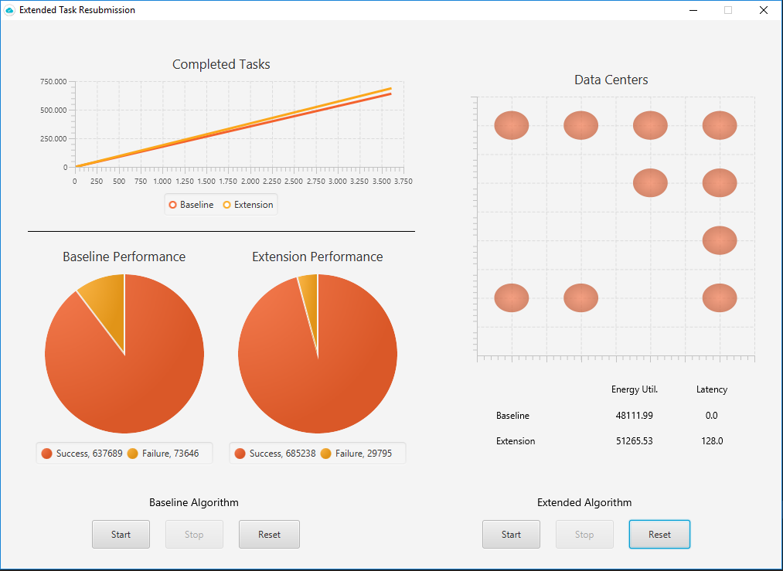
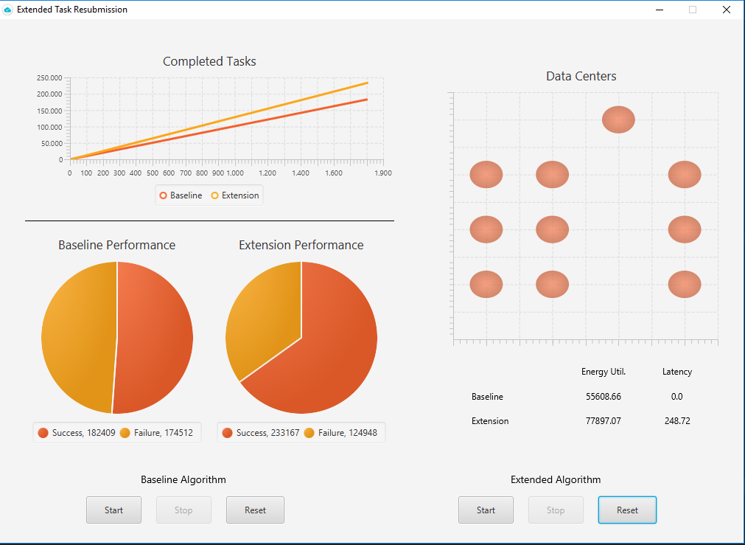
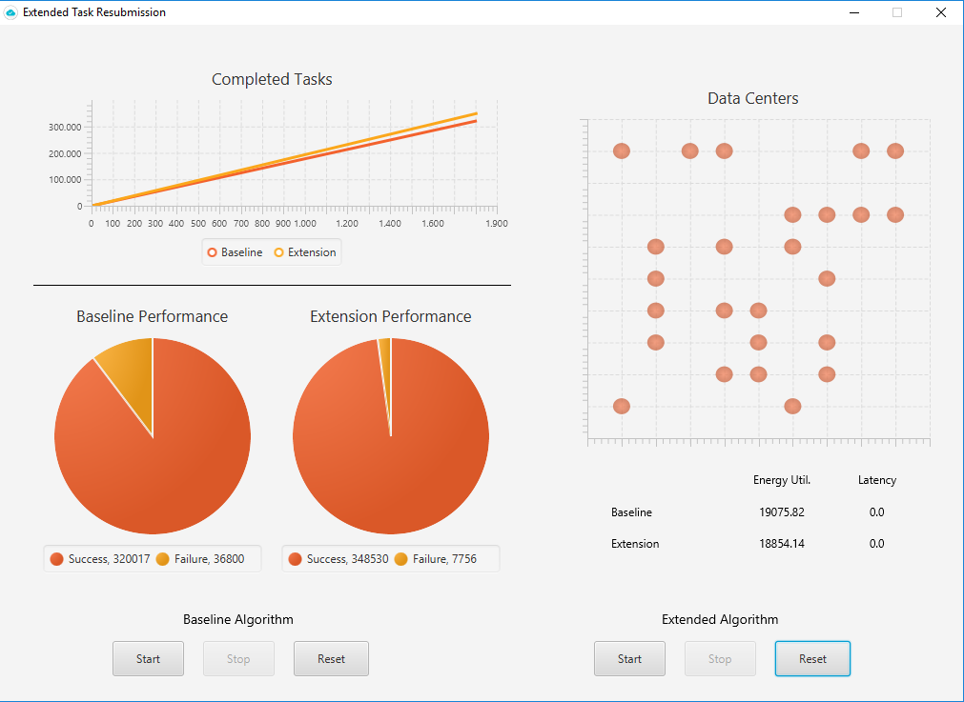
Results
Overview
Architecture
Implementation
Setup
Results
Default
Modified Successrate
Modified Scale

Slide 8
Results
Overview
Architecture
Implementation
Setup
Results
 | Default |  | Modified Successrate |  | Modified Scale
 | Baseline | Extension | Baseline | Extension | Baseline | Extension
Success | 89.65 % (637,689) | 95.83 % (685,238) | 51.11 % (182,409) | 65.11 % (233,167) | 89.69 % (320,017) | 97.82 % (348,530)
Failure | 10.35 % (73,646) | 4.17 % (29,795) | 48.89 % (174,512) | 34.89 % (124,948) | 10.31 % (36,800) | 2.18 % (7,756)
Energy Utilization | 48,111.99 | 51,265.53 | 55,608.66 | 77,897.07 | 19,075.82 | 18,854.14
Latency | 0 ms | 128 ms | 0 ms | 248.72 ms | 0 ms | 0 ms

Slide 9
Results
Overview
Architecture
Implementation
Setup
Results
 | Default |  | Modified Successrate |  | Modified Scale
 | Baseline | Extension | Baseline | Extension | Baseline | Extension
Success | 89.65 % (637,689) | 95.83 % (685,238) | 51.11 % (182,409) | 65.11 % (233,167) | 89.69 % (320,017) | 97.82 % (348,530)
Failure | 10.35 % (73,646) | 4.17 % (29,795) | 48.89 % (174,512) | 34.89 % (124,948) | 10.31 % (36,800) | 2.18 % (7,756)
Energy Utilization | 48,111.99 | 51,265.53 | 55,608.66 | 77,897.07 | 19,075.82 | 18,854.14
Latency | 0 ms | 128 ms | 0 ms | 248.72 ms | 0 ms | 0 ms

Slide 10
Results
Overview
Architecture
Implementation
Setup
Results
 | Default |  | Modified Successrate |  | Modified Scale
 | Baseline | Extension | Baseline | Extension | Baseline | Extension
Success | 89.65 % (637,689) | 95.83 % (685,238) | 51.11 % (182,409) | 65.11 % (233,167) | 89.69 % (320,017) | 97.82 % (348,530)
Failure | 10.35 % (73,646) | 4.17 % (29,795) | 48.89 % (174,512) | 34.89 % (124,948) | 10.31 % (36,800) | 2.18 % (7,756)
Energy Utilization | 48,111.99 | 51,265.53 | 55,608.66 | 77,897.07 | 19,075.82 | 18,854.14
Latency | 0 ms | 128 ms | 0 ms | 248.72 ms | 0 ms | 0 ms

Slide 11
Results
Overview
Architecture
Implementation
Setup
Results
Compare to SLAs
Maximize Number of Completed Jobs
The Success-Rate of Distributed Jobs Must be Higher Than 80%
Minimize Latency
A Job is Always Transferred to the Next Best PM
The Average Latency Must be Lower Than 500 ms
Keep Energy Utilization in Suitable Area
Energy Consumption Must be Lower Than 80.000
 | Default
 | Baseline | Extension
Success | 89.65 % (637,689) | 95.83 % (685,238)
Failure | 10.35 % (73,646) | 4.17 % (29,795)
Energy Utilization | 48,111.99 | 51,265.53
Latency | 0 ms | 128 ms

